Slide 1
Automatic Car Wash Simulation
By
Atrayee Bhadra
Heba Alsultaan
Mustafa Alkhafaji
Sindhuja Nandikonda

Slide 2
Outline
Automatic car wash station
Types of car wash
Simulation progress & some calculations
Data analysis

Slide 3
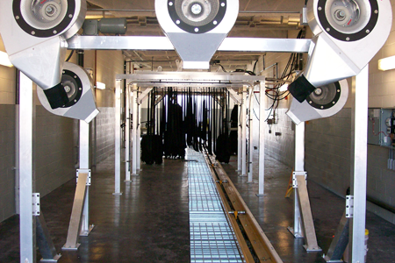
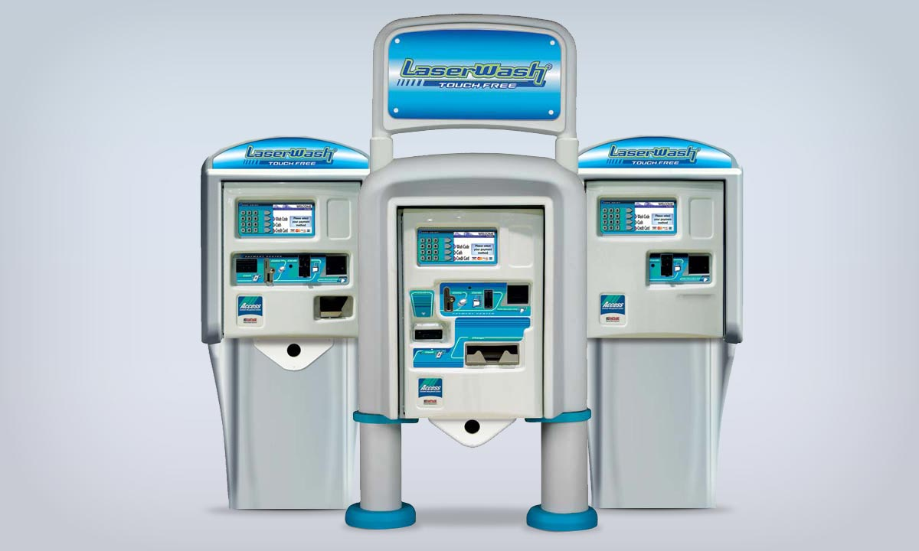
Introduction
The first conveyorized automatic car washes appeared in the late 1930s. Conveyorized automatic car washes consist of tunnel-like buildings into which customers (or attendants) drive.

Slide 4
Getting into Project Details...
Two kinds of car wash methods:
Superdog
Topdog
Resources:
Water
Electricity
Washing Liquids

Slide 5
Data Collected
Electric Car wish with one Queue and one service station
Timings: Open 24hrs each day
Total cost to build the station= $1000000
Average number of cars everyday=55
Traffic hours: 10:00am to 4:00pm

Slide 6
Kinds of wash
Kind of wash | Cost | Time Slot | Avg. of cars
SUPER DOG | $11 | 5 minute | 25
TOP DOG | $13 | 7 minute | 30

Slide 7
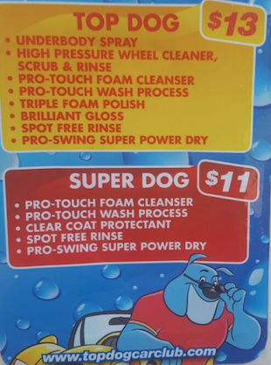
The properties of each kind

Slide 8
Simulation Steps
Whole process is divided into two basic transactions namely, Superdog(5) and Topdog(7)
i. Simulated arrival time ,service time , and departure time for each customer
ii. Found maximum queue lengths and average customer wait times

Slide 9
Simulation Steps
iii. Calculated daily and monthly revenue
iv. Calculated monthly profit
v. Estimated the return on investment time period(in days)
vi. Applied Monte Carlo technique to analyze the range of time period to get back the investment

Slide 10
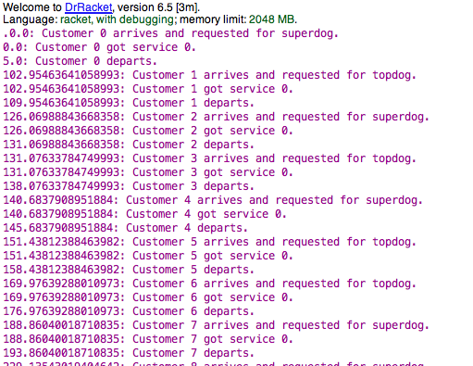
Generation of arrival time and processes:

Slide 11
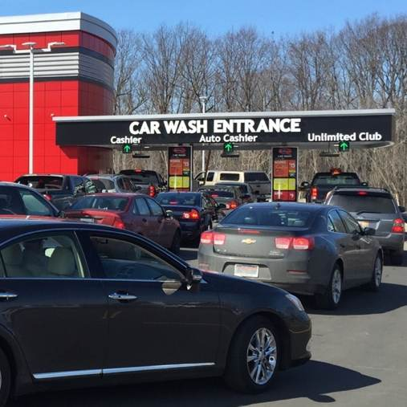
Max Queue Length & Average Wait Time:
Max queue length= the max number of cars that wait in queue at certain time
Average wait time= total customers wait time / number of customers

Slide 12

Daily and Monthly Revenues:
SUPER DOG revenue = number of SUPER DOG customer's * $ 11
TOP DOG revenue = number of TOP DOG customers* $ 13
Daily revenue = Σ (SUPERDOG revenue+ TOP DOG revenue )
Monthly Income = Daily revenue * 30

Slide 13

Cost and Profit
The profit for the carwash = monthly income - monthly expenses
Monthly Resource Cost= (electricity + water + washing liquid ) for both types of wash
Monthly profit = Monthly Income - Monthly Resource Cost
Return On Investment time period(days)= investment / daily profit

Slide 14
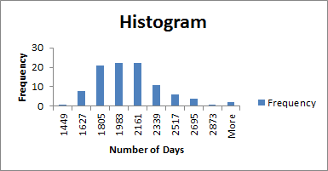
Analysis

Slide 15
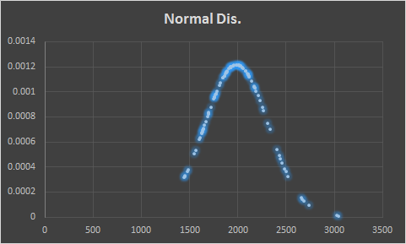
Analysis Continued
Confidence interval=( mean-2*std.deviation, mean+2*std.deviation)=(1365.204,2615.684)
95% confidently, we can assure the owner that he is going to get back his investment without exceeding 2615 days

Slide 16
Conclusion
Simulated different parameters like:
Arrival and service time
Departure time
Average wait times
Maximum Queue Length
Revenue
Cost incurred due to different resources
monthly profit
Return on investment period

Slide 17
Continuation….
Performed Monte Carlo Analysis on return on investment period
Performed histogram analysis and normal distribution on return on investment period

Slide 18


Slide 19
Thank you Dr. M. Douglas Williams for your help
Thank you friends for listen

